Slide 1
Family Promise of Bristol
Notes:
1

Slide 2
Community Needs Assessment
In 2009, community leaders identified homelessness as a large problem for families with children
In 2011, Family Promise of Bristol was developed as a non-profit to assist homeless families with children
Joined over 140 Family Promise affiliates nationally

Slide 3
Program Design
Church facilities house guests overnight for a week at a time.
Food, shelter and transportation costs are completely covered by the program using volunteer support and donations.
12 host churches
11 support churches
Hundreds of volunteers

Slide 4
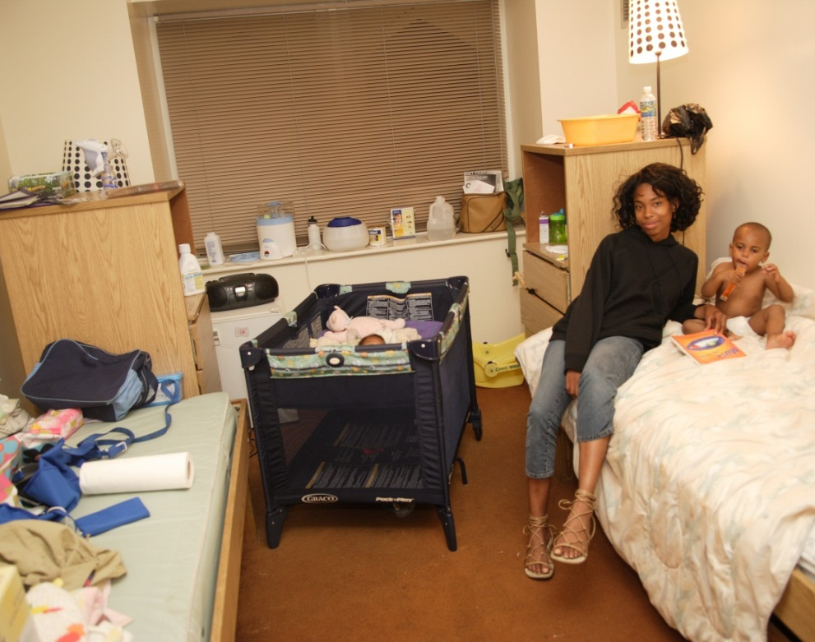
Guest Rooms
Guest rooms are private, either an existing room or partitioned space in a larger room.
Includes:
Cots
Nightstand
Anything else that can make it feel like home

Slide 5
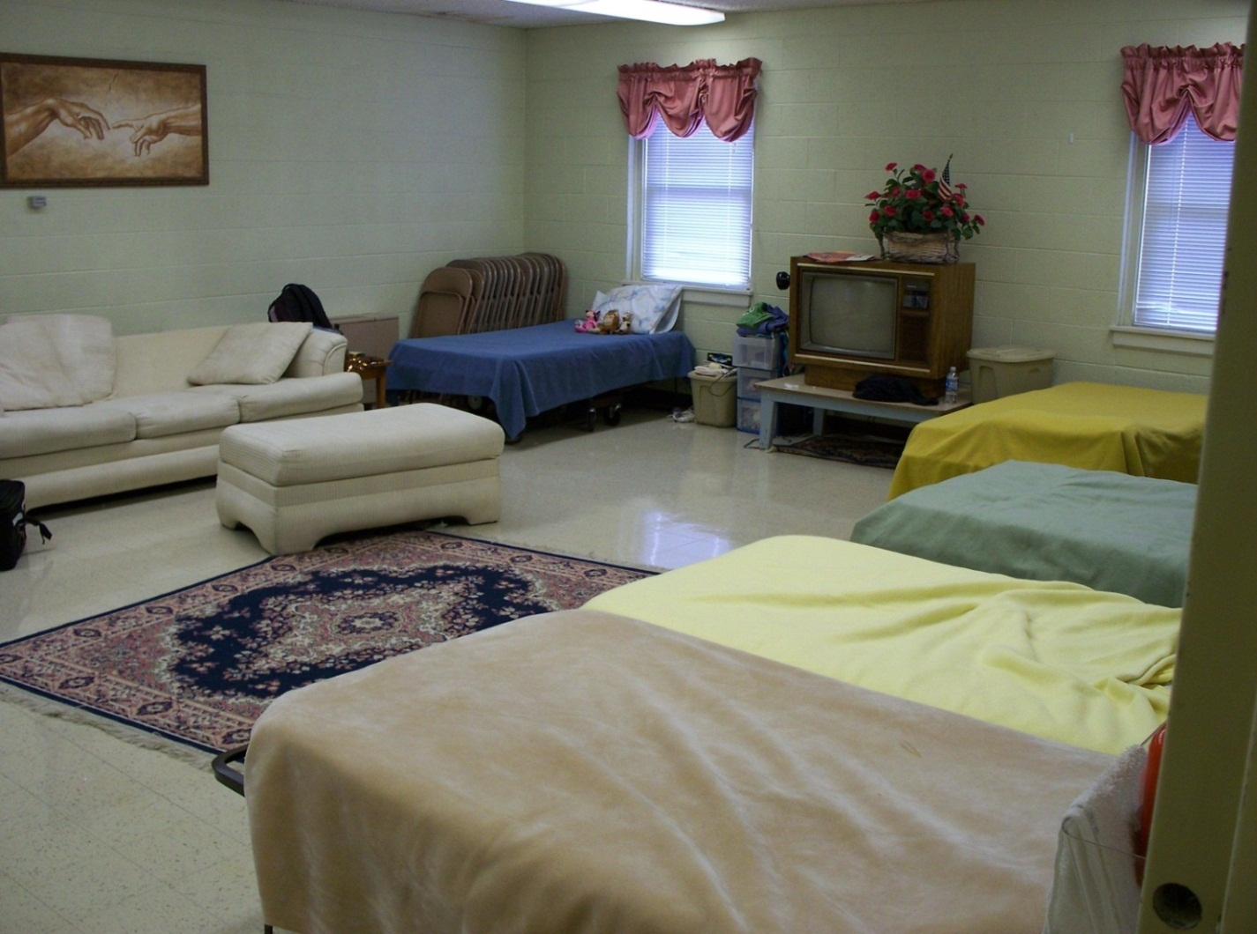
A congregation’s parlor converted to a space for a guest family of five

Slide 6
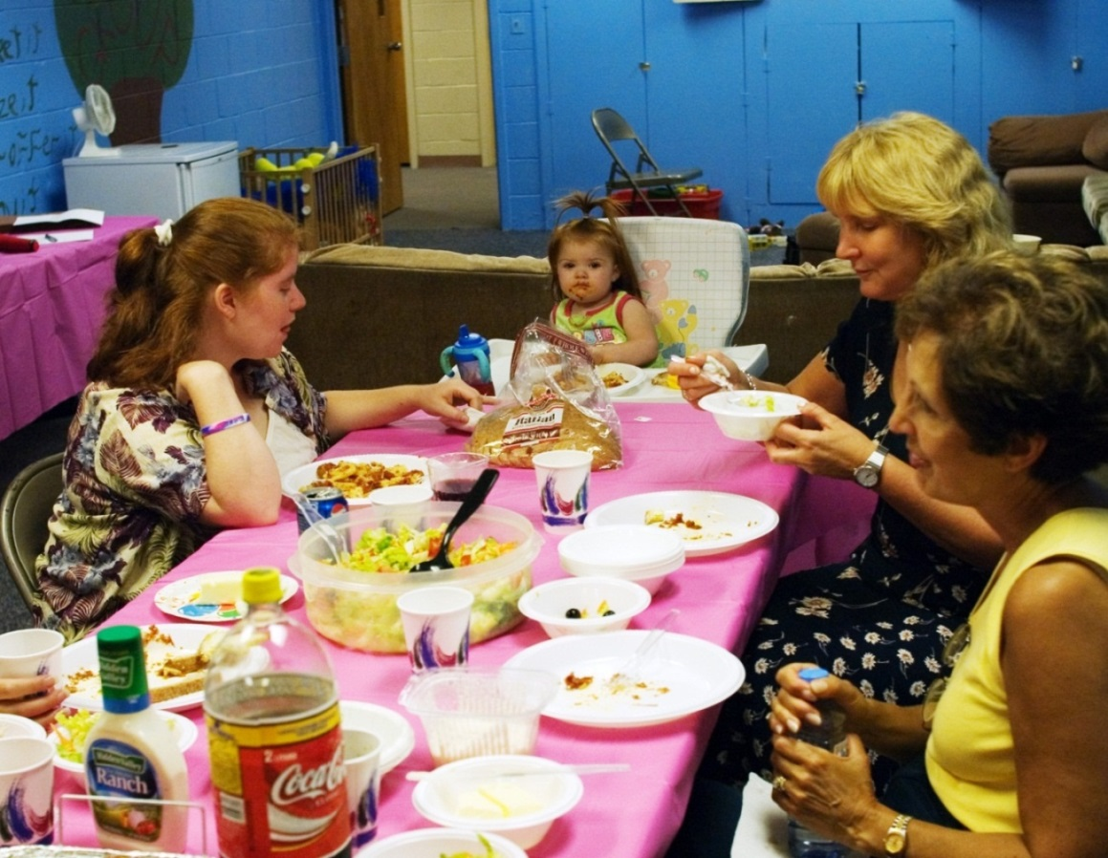
Meals
Meals are family style, with guests and hosts dining together.

Slide 7
Breakfast and Lunch
In addition to dinner, the host congregation provides breakfast, and for lunch cold cuts that guests can use to make their own sack lunches.

Slide 8
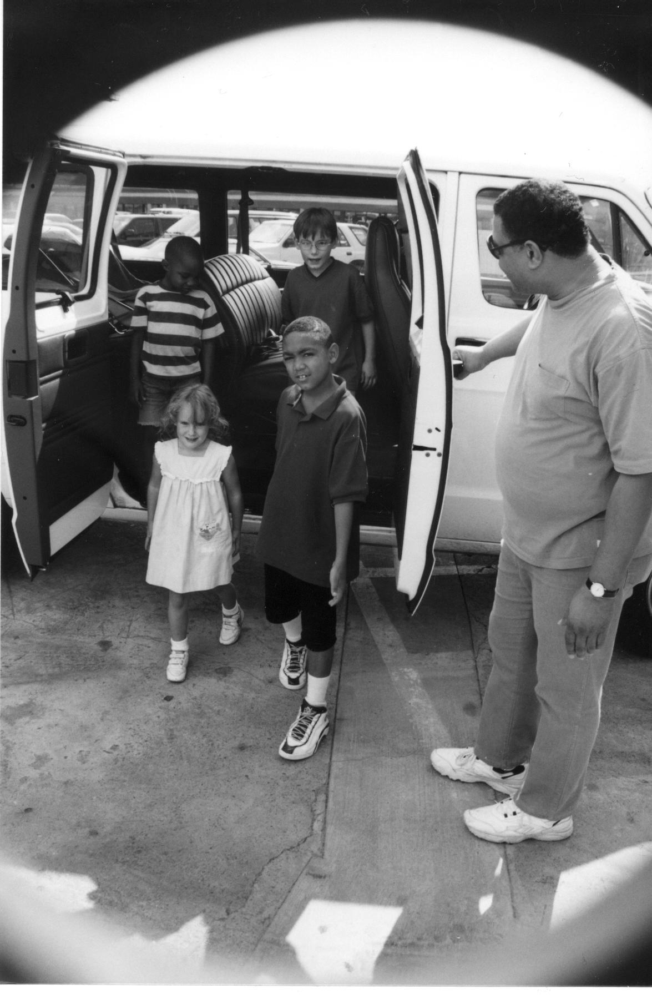
Transportation
The van picks families up in the morning and takes them to the day center.
In the late afternoon, the families return to the host congregation.

Slide 9
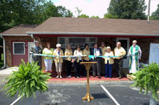
Day Center
This is where guests can take showers, keep belongings, do job searches and where they have a physical address. It is also where volunteers help out with answering phones and other odd jobs and also ensure coverage if the staff needs to be away at some point during the day.

Slide 10
Cost savings by using facilities already available
Strong network of churches and volunteers leads to the stability of the program and incorporates vulnerable families into the community
76% of families served are in permanent, stable housing one year after exit.
Families save money and/or pay off debts while in the program
Case Managers provide support to obtain housing and to avoid homelessness in the future.

Slide 11
Lane Family

Slide 12
For More Information:
Angie Sproles
Executive Director
Family Promise of Bristol
Phone: 276-494-0388
Email: familypromiseofbristol@gmail.com

